Slide 1
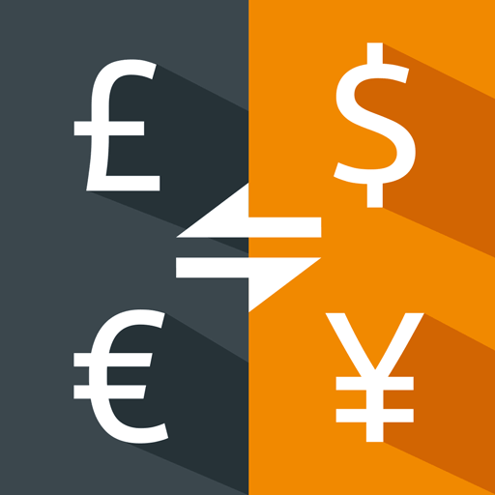

Currency Converter
A REACT APPLICATION
PRESENTED BY A. RATNAKUMAR
R. HARI NARAYANAN
MITTA VAMSI
PRADEEP
SRI SUDHARSSAN

Slide 2
OUTLINE
ABSTRACT
OBJECTIVE
ARCHITECTURE
MODULES
IMPLEMENTATION
OUTPUT
CONCLUSION
REFERENCES

Slide 3
ABSTRACT
The Currency Converter is an innovative and versatile financial tool designed to facilitate seamless currency exchange and conversion in a user-friendly manner.
This software application aims to assist individuals, businesses, and financial institutions in efficiently handling cross-border transactions, managing foreign investments, and staying updated with real-time exchange rates.

Slide 4
OBJECTIVE
Currency Converter is a powerful and indispensable financial tool that empowers individuals and businesses to navigate the complexities of currency exchange with ease.
The Currency Converter is accessible on web, mobile, and desktop platforms, promoting convenience and global financial connectivity.

Slide 5
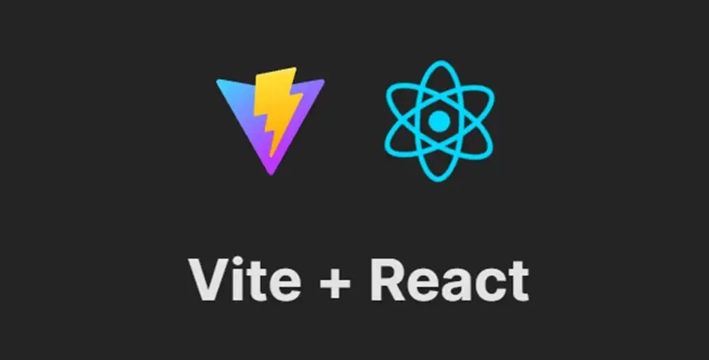
TECHNOLOGY STACK

Slide 6
ARCHITECTURE DESIGN
Select From and To Country to Convert the Currency
Enter
Amount
Performs
Calculation
User
Free Currency API
Based on
User I/P
Equivalent
Result
Displayed

Slide 7
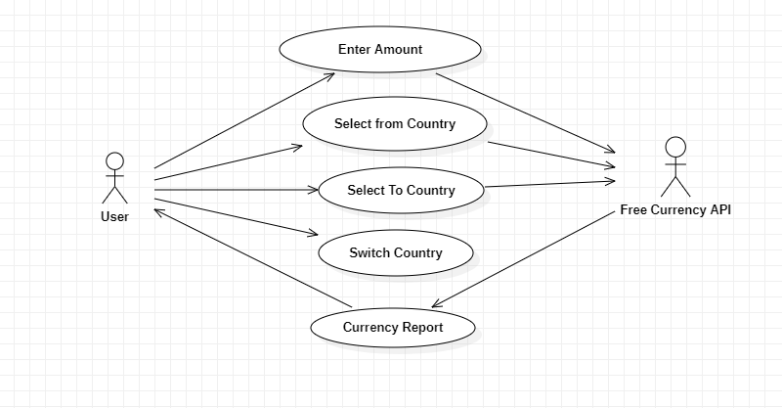
UML :- Use Case Diagram

Slide 8
MODULES
Input Amount
Select From Country
Flag
Amount Name
Country Name
Select To Country
Switch Countries
Converted Currency

Slide 9
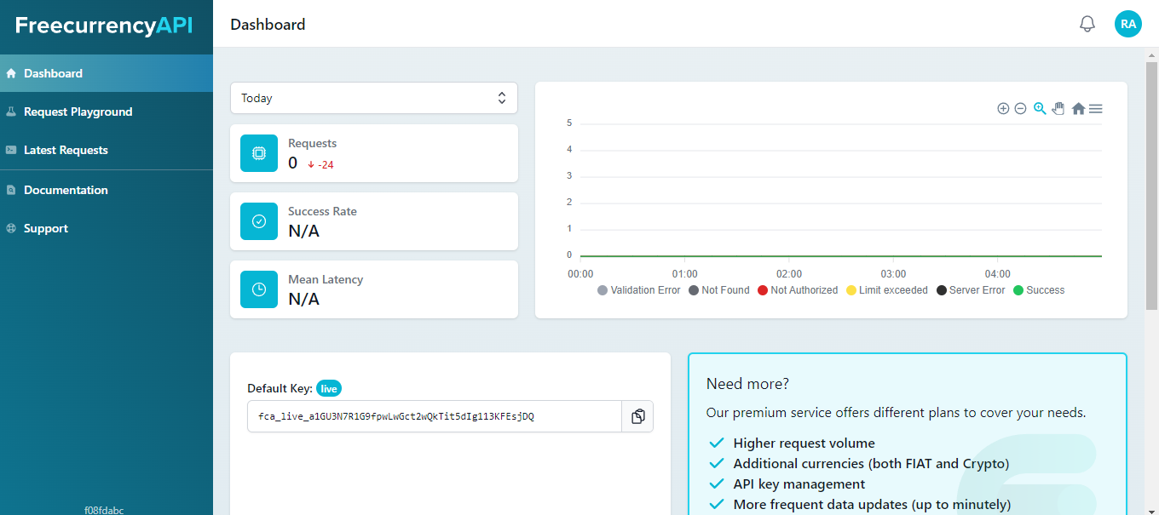
IMPLEMENTATION

Slide 10
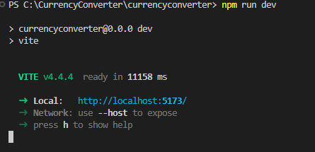
IMPLEMENTATION

Slide 11
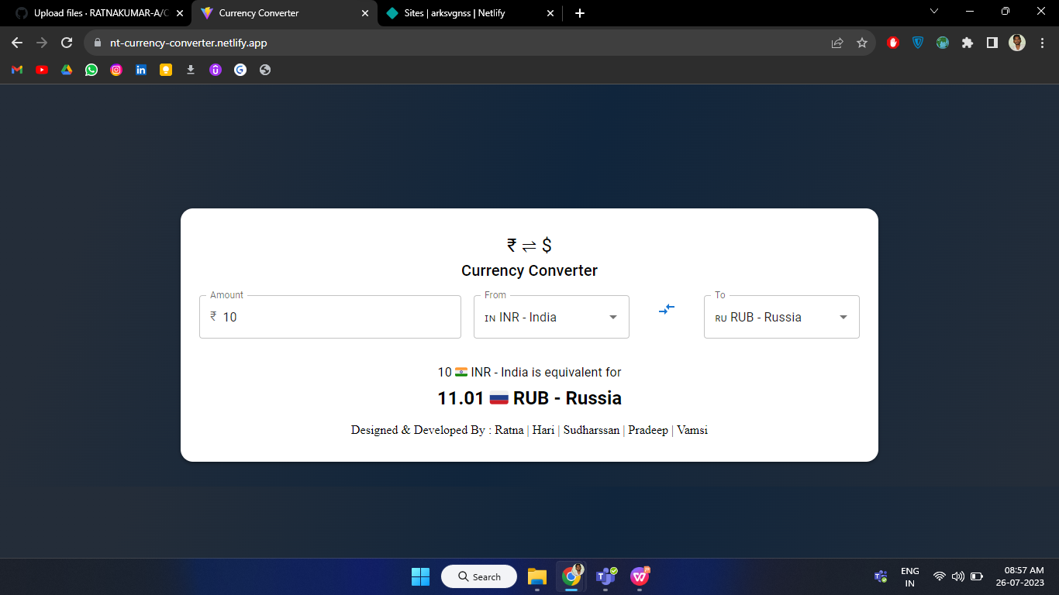
IMPLEMENTATION
Hosted as a Real Time Application
Netlify is a cloud-based platform and hosting service that simplifies the process of deploying, managing, and scaling modern web applications and websites.
https://nt-currency-converter.netlify.app/

Slide 12
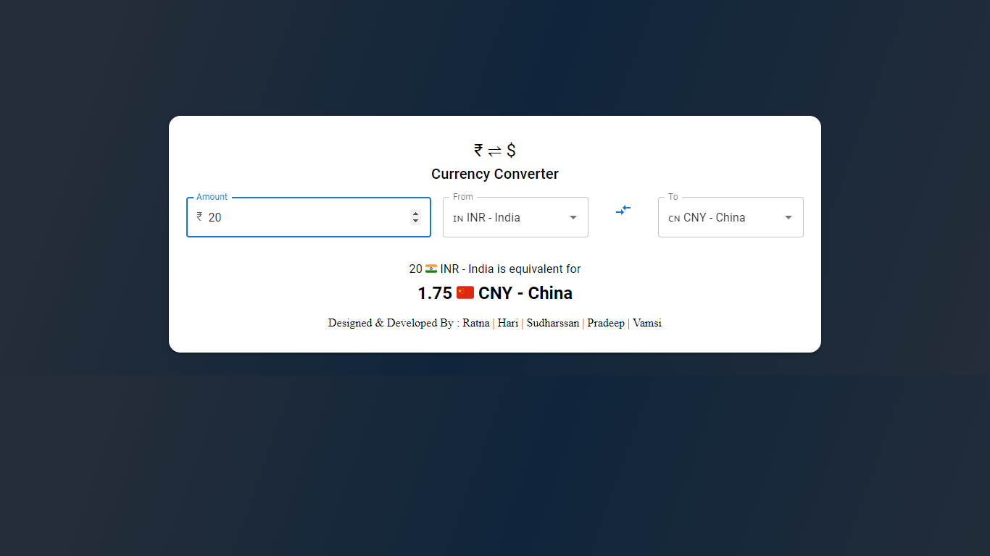
OUTPUT

Slide 13
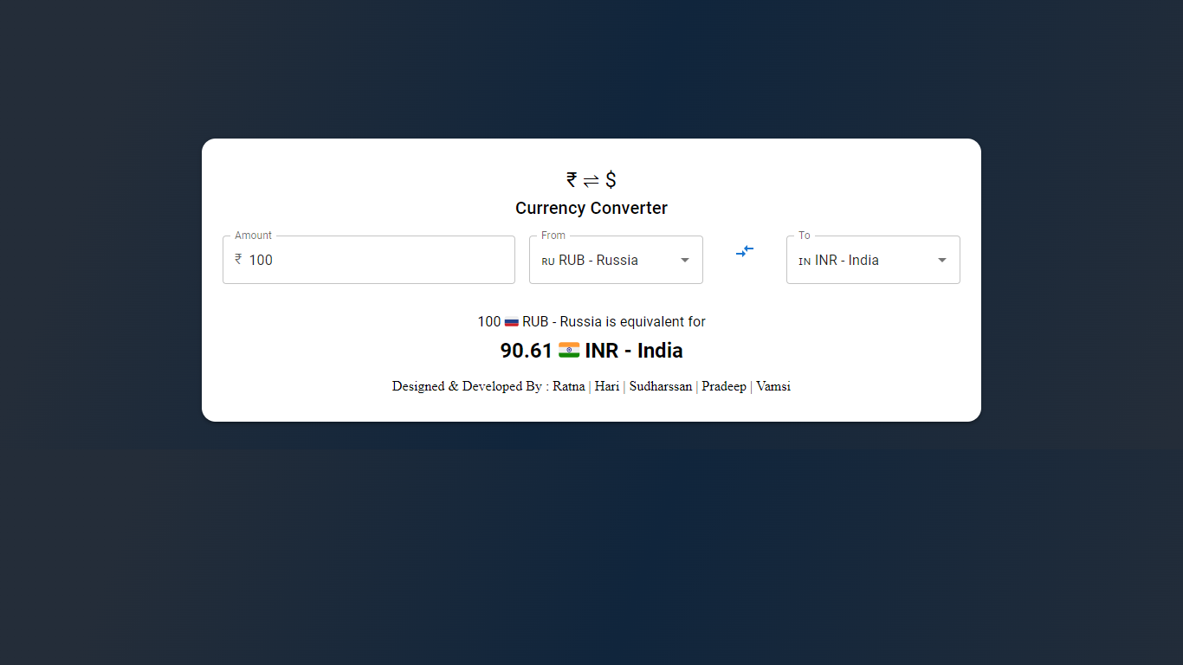
OUTPUT

Slide 14
CONCLUSION
In conclusion, the Currency Converter app is a valuable and efficient financial tool that serves as a reliable companion for individuals and businesses engaged in currency exchange transactions.
The app's support for a wide range of global currencies enables users to convert between different denominations effortlessly.
The app's user-friendly and customizable interface ensures a seamless user experience, allowing individuals to personalize the platform to suit their preferences and requirements.

Slide 15
REFERENCES
https://vitejs.dev/guide/
https://mui.com/material-ui/getting-started/
https://react.dev/learn
https://app.freecurrencyapi.com/dashboard
https://docs.staruml.io/

